Slide 1
Professor
Jorge Alfonso Meléndez Acuña

Slide 2
Welcome
Centrality measures are critical in a wide-range of applications that involve concepts/phenomena such as:
Infrastructure vulnerability and robustness (e.g., in transportation systems, urban systems, the Internet, etc.).
Efficient Communication within a network.
Dissemination of information, Spread of Diseases.
Power, Control, spread of information in a social network.

Slide 3
Schedule
Network Science for Data Analytics
Unit 1
Introduction to Network Analysis
Unit 2
Centrality
Measures
Unit 3
Introduction to Network Models
Unit 4
Community Detection
Unit 5
Error and Attack Tolerance
Unit 6
Graph Machine Learning
Introduction to
Data Science
Basic Concepts of Graph Theory
Hubs
Communities
Vulnerability in networks
Machine Learning with Graphs
Introduction to Network Science
Small Worlds
Network Models
Deep Learning with Graphs

Slide 4
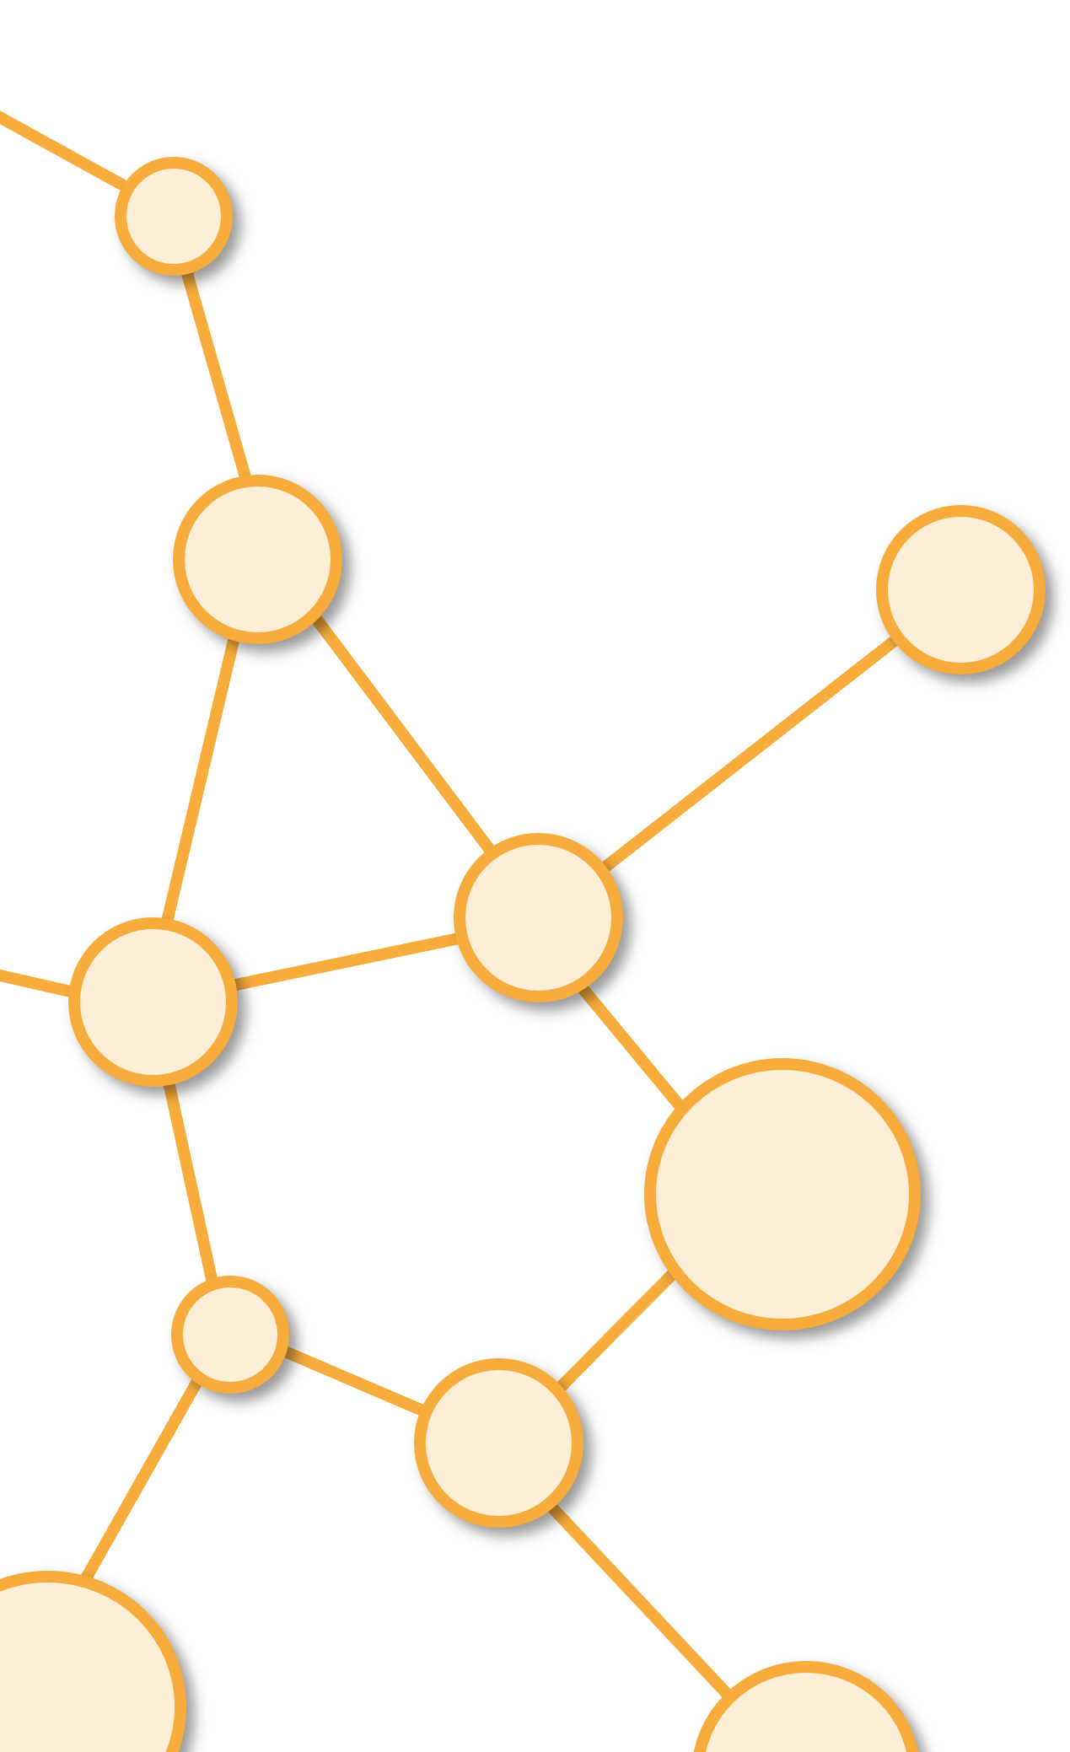
Centrality Measures
Unit 2

Slide 5
Outline
1. Degree Centrality
2. Closeness Centrality
3. Betweenness Centrality
4. Eigenvector Centrality

Slide 6
Degree Centrality
1

Slide 7
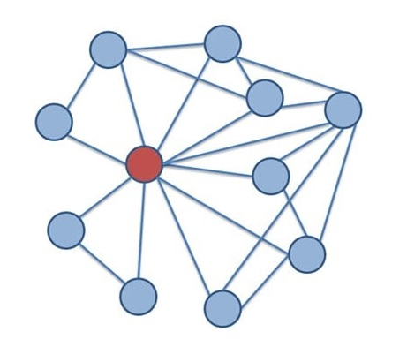
Degree Centrality
Centrality depends on the degree of node (number of neighbors).
Nodes with high degree centrality are often referred to as "hubs" or "influencers”.
Nodes with high degree centrality are not only important but also vulnerable.
Reference: Andrew Beveridge. (2020, September 2). NetSci 03-2 Basic Centrality Measures. [Video]. YouTube. https://www.youtube.com/watch?v=uM8USKnYiig

Slide 8
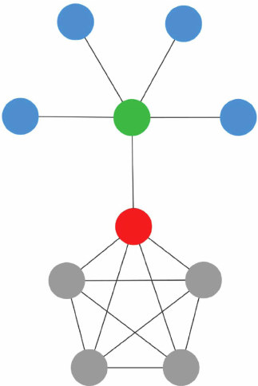
Degree Centrality
Nodes with high degree centrality can serve as efficient channels for spreading information or coordinating activities.
Nodes with high degree centrality are often primary targets for intervention (Spread of Diseases).
Changes in degree centrality over time or differences in degree centrality between networks can provide insights into evolving relationships, behaviors, or structural changes.
Reference: Andrew Beveridge. (2020, September 2). NetSci 03-2 Basic Centrality Measures. [Video]. YouTube. https://www.youtube.com/watch?v=uM8USKnYiig

Slide 9
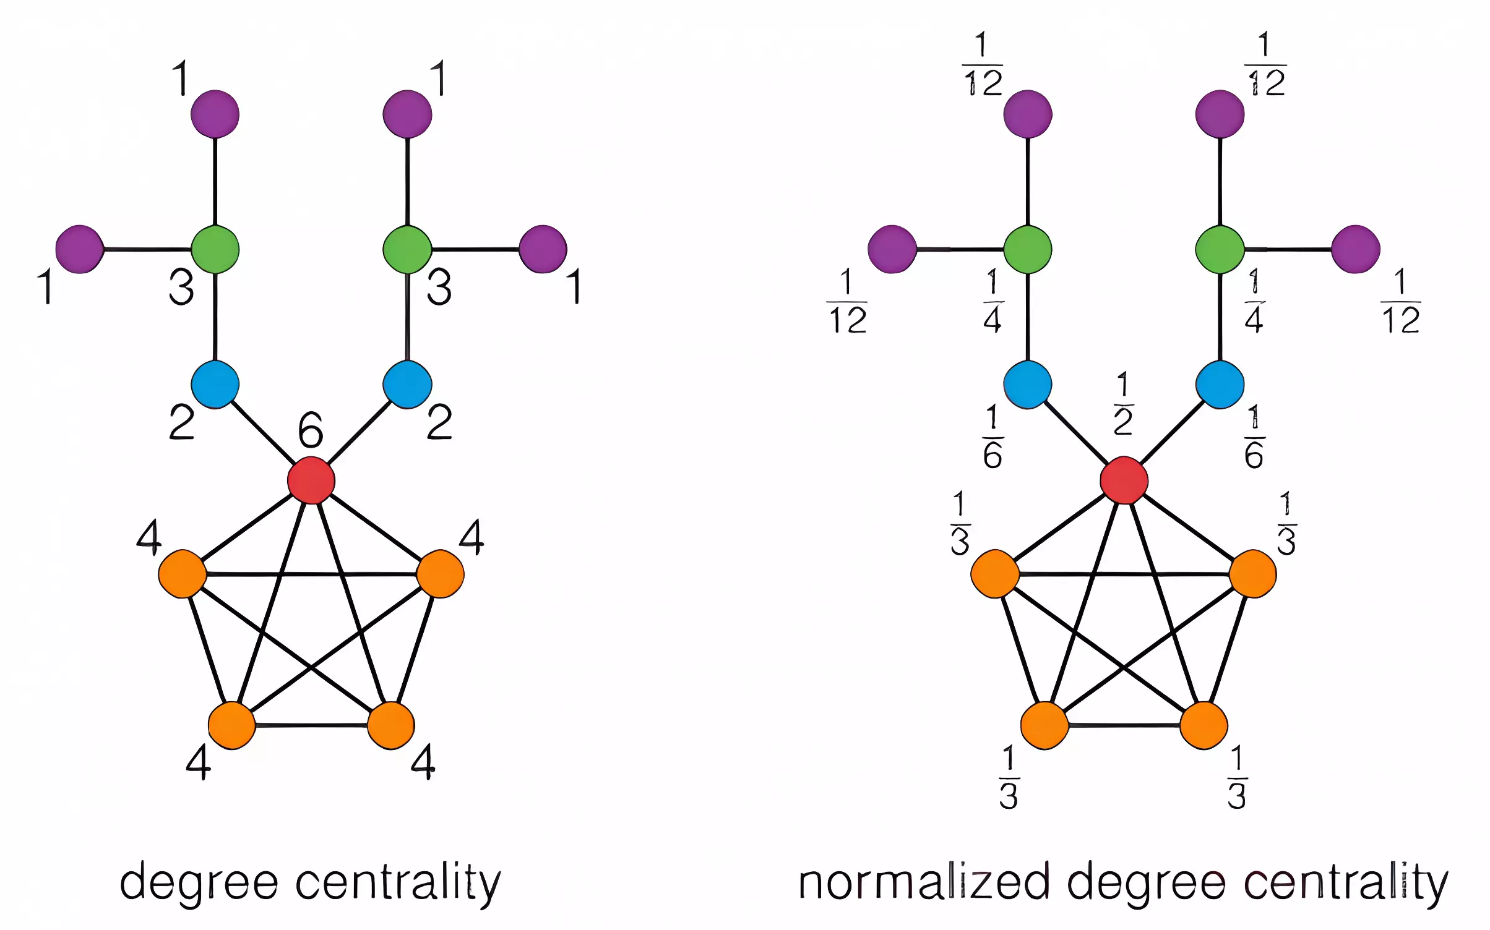

Example of degree centrality
Link to Model
Reference: Andrew Beveridge. (2020, September 2). NetSci 03-2 Basic Centrality Measures. [Video]. YouTube. https://www.youtube.com/watch?v=uM8USKnYiig

Slide 10
Closeness Centrality
2

Slide 11
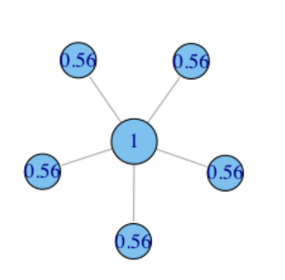
Closeness Centrality
Closeness centrality measures how close a node is to the other nodes in the network.
Nodes with high closeness centrality can efficiently communicate with other nodes and have quick access to information or resources.
Closeness centrality is important for understanding communication efficiency, transportation accessibility, or information dissemination within networks.
It is often used in transportation networks to identify nodes with quick access to various destinations.
Reference: Andrew Beveridge. (2020, September 2). NetSci 03-2 Basic Centrality Measures. [Video]. YouTube. https://www.youtube.com/watch?v=uM8USKnYiig

Slide 12


Closeness Centrality
FarNess:
Being the Geographic center makes you important.
You are never far from the action
Uses shortest-path-lengths.
Farness: Mean distance to other nodes.
Closeness: Inverse of farness.
Closeness:
Link to Model
Reference: Andrew Beveridge. (2020, September 2). NetSci 03-2 Basic Centrality Measures. [Video]. YouTube. https://www.youtube.com/watch?v=uM8USKnYiig

Slide 13
Betweenness Centrality
3

Slide 14
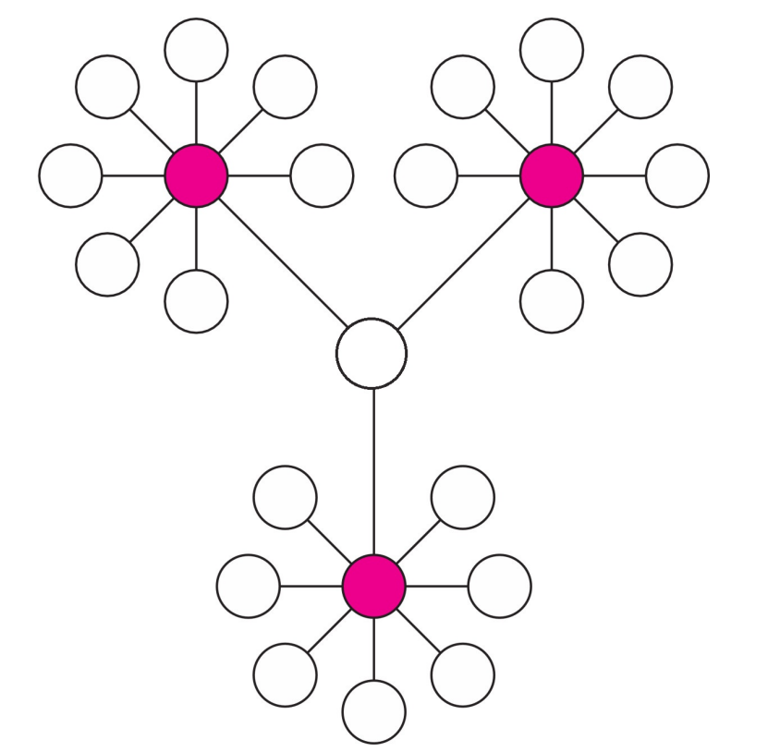
Betweenness Centrality
Nodes with high betweenness centrality often serve as critical "bottlenecks" in a network
These nodes lie on many shortest paths between other nodes, meaning they control the flow of information, resources, or influence
They act as bridges or intermediaries connecting different parts of the network.
Reference: Andrew Beveridge. (2020, September 2). NetSci 03-2 Basic Centrality Measures. [Video]. YouTube. https://www.youtube.com/watch?v=uM8USKnYiig

Slide 15


Betweenness Centrality
Analyzing betweenness centrality can help to identify potential points of failure and inform strategies for enhancing network resilience and robustness.
Messages within the network pass through you. You are a “bridge” between clusters of the network.
: Shortest paths from s to t that go through v
: Shortest paths from s to t
Reference: Andrew Beveridge. (2020, September 2). NetSci 03-2 Basic Centrality Measures. [Video]. YouTube. https://www.youtube.com/watch?v=uM8USKnYiig

Slide 16
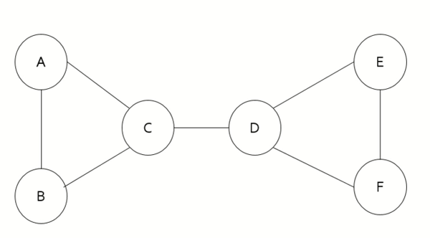
Betweenness centrality of node C?
Link to Model

Slide 17
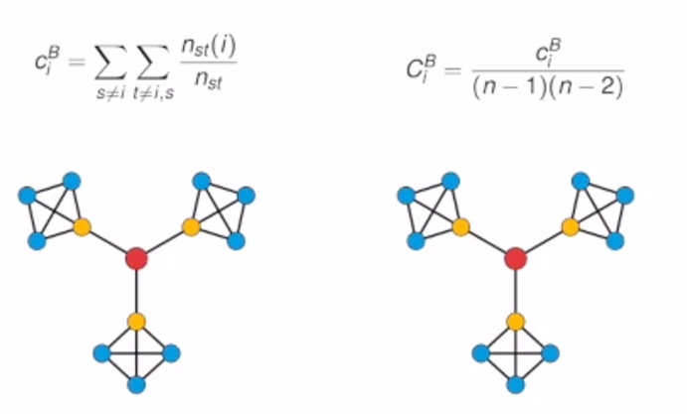
Another Example
Shortest paths are unique.
By symmetry there are only 3 values (corresponding to the three colors).
Link to Model
Reference: Andrew Beveridge. (2020, September 2). NetSci 03-2 Basic Centrality Measures. [Video]. YouTube. https://www.youtube.com/watch?v=uM8USKnYiig

Slide 18

Application of Centrality measures
Lusseau and Newman Dolphins Network
NetSci 03-3 Centrality in a Dolphin Network

Slide 19
Eigenvector Centrality
4

Slide 20
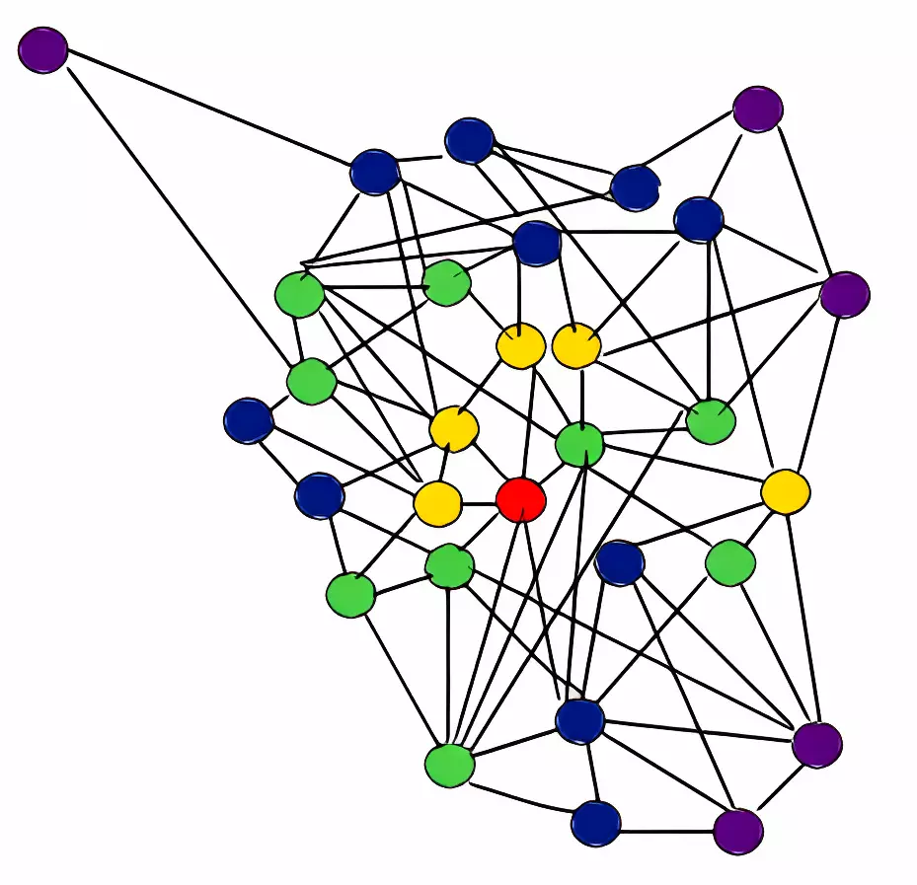
Eigenvector Centrality
Degree centrality is “miopic”. It ignores the place of the node in the network,
It takes into account not only the number of connections a node has but also the importance of the nodes to which it is connected.
Reference: Eigenvalue Centrality. Taken from Eigenvector Centrality (Centrality Measure) – GeeksforGeeks.

Slide 21
Eigenvector Centrality
In social networks, individuals with high eigenvector centrality are often influential opinion leaders or trendsetters.
Nodes with similar eigenvector centrality scores are likely to belong to the same community or module within the network. This can help uncover hidden structures and relationships within complex networks.
Nodes with high eigenvector centrality are often perceived as prestigious or influential within the network.
It helps to identify key players in a network who have indirect influence through their connections to other influential nodes.

Slide 22
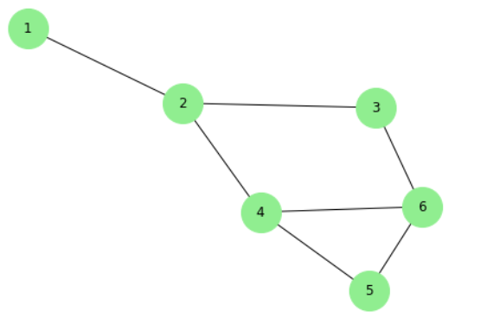
Example
Which node has more power?
2,4 or 6

Slide 23
Look at the neighbors (Links give power)
1
2
7
6
3
Link to Exel Model
2
3
3
3
8
2
2
New Power: Sum of power
of my neighbors
Reference: Andrew Beveridge. (2020, September 2). NetSci 03-2 Basic Centrality Measures. [Video]. YouTube. https://www.youtube.com/watch?v=uM8USKnYiig

Slide 24
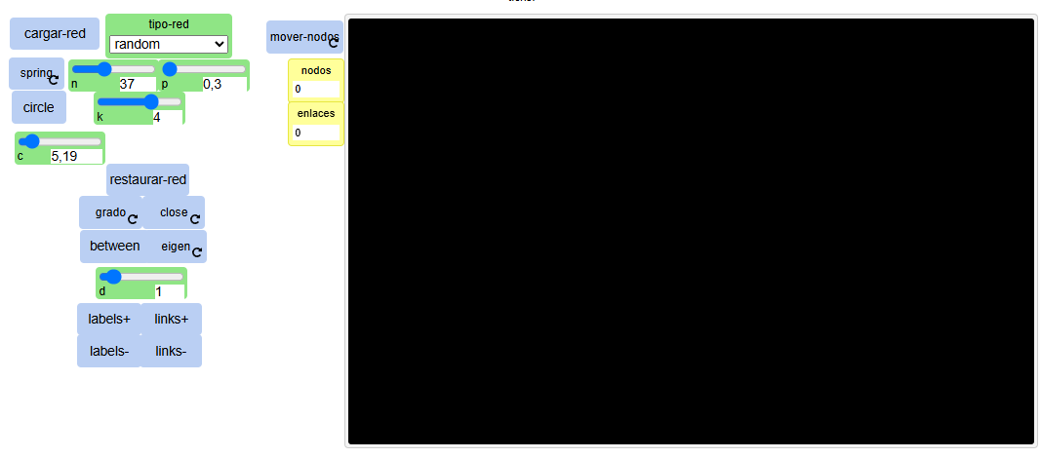
All Centralities - Model
Centralities Model

Slide 25
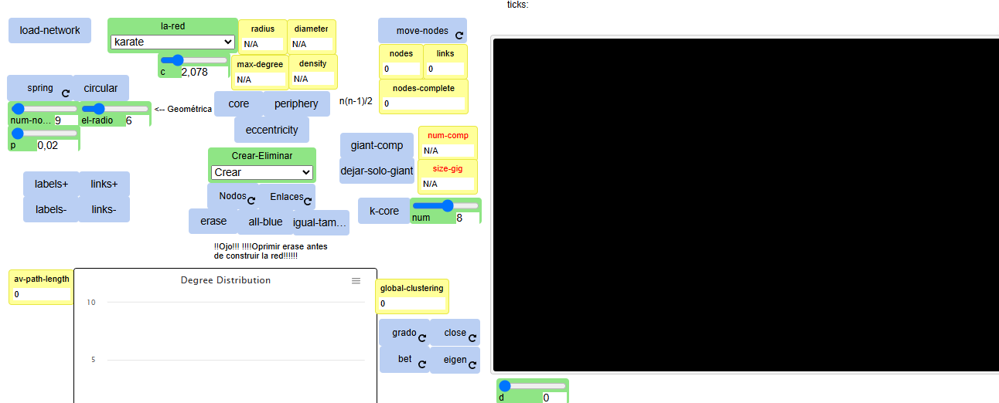
Local and global measures
Local and Global Model

Slide 26
Summary
Degree-centrality: Centrality depends on the degree of a node (number of neighbors)
Closeness-Centrality: Centrality depends on the distance of a node to the other nodes
Betweenness-centrality: Centrality depends on how many shortest paths pass through a node.
Eigenvector-Centrality: Importance of a node depends on the importance of neighbour nodes (recursive definition)

Slide 27
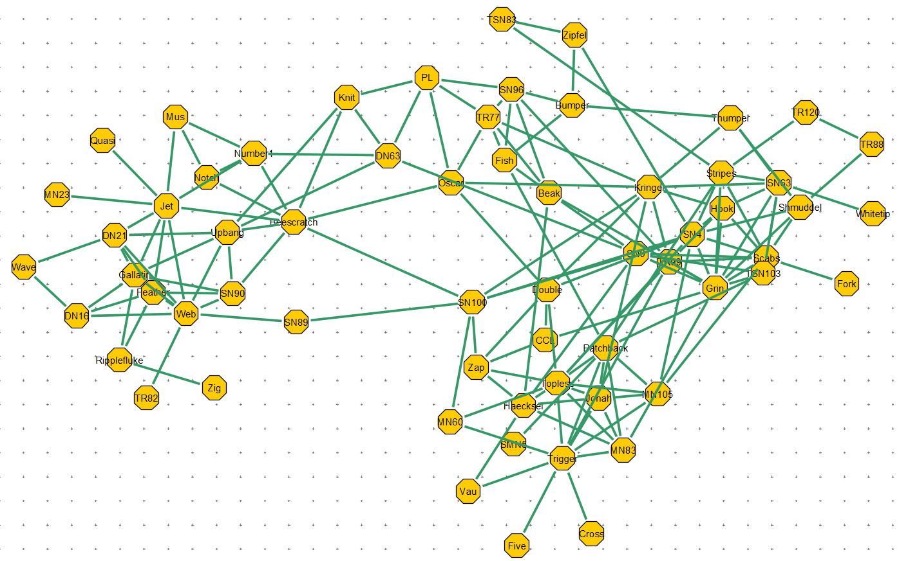
Andrew Beveridge Dolphins Network Video (4 Min)

Slide 28
Real Life Applications
Diffusion
Vulnerability
Link to Model

Slide 29
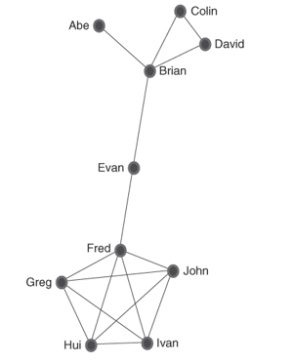
Example 4 centralities
Link to PPT for the Google Meet Chat

Slide 30
!
Activities
Tarea parte 1
Tarea parte 2
Taller
Calcular mínimo 4 medidas locales y 4 globales vistas en clase
Comentar en el Foro ¿Cuál puede ser la utilidad de estas medidas si quiere hacer un análisis básico de la red?
Notebook: Centralidad. El fenómeno del mundo pequeño en redes reales y simulaciones

Slide 31
Good bye
We hope that the information in this study material has contributed to the understanding of the most important concepts of this topic.
We invite you to continue reviewing all the educational materials available on the platform.

Slide 32
References
Closeness centrality . Taken from Data Viz | Jacob Jameson
Dr. Ian McCulloh. YouTube Channel. https://www.youtube.com/@dr_smoke/videos
Reference: Andrew Beveridge. (2020, September 2). NetSci 03-2 Basic Centrality Measures. [Video]. YouTube. https://www.youtube.com/watch?v=uM8USKnYiig

Slide 33
Image copyright
Closeness centrality . Taken from Data Viz | Jacob Jameson
Eigenvalue Centrality. Taken from Eigenvector Centrality (Centrality Measure) – GeeksforGeeks
Reference: Andrew Beveridge. (2020, September 2). NetSci 03-2 Basic Centrality Measures. [Video]. YouTube. https://www.youtube.com/watch?v=uM8USKnYiig

Slide 34
Credits
Subject Matter Expert
Instructional Designer
Jorge Alfonso Meléndez Acuña
Angela Maria Arboleda Restrepo
Subject Matter Expert
Graphic Designer
Luis Fernando Niño Vásquez
Tania Valentina Flórez Rincón
First version
Date: April 2025

